Slide 1

Knight Bites
Aayam Shrestha
Anjana Sainju
Charles Duimstra
Ifeanyi Onyeanakwe

Slide 2
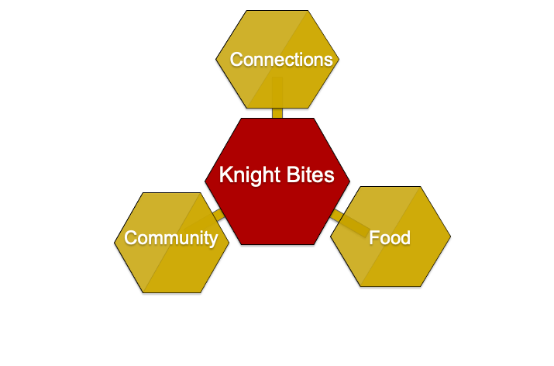
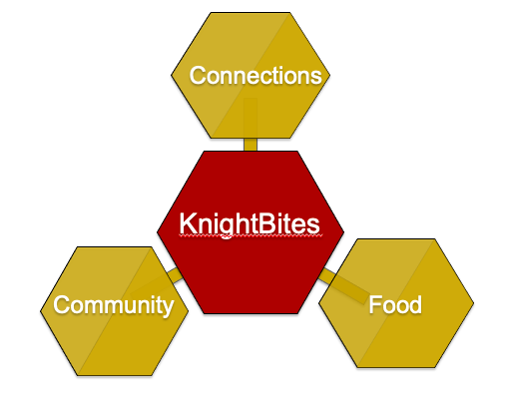
Our Vision
KnightBites

Slide 3
Why Knight Bites?
Solving student hunger by making off-campus meals more accessible.
Bringing more attention to an underutilized student service.
A solution to how the pandemic ruined our social skills.

Slide 4
Demo

Slide 5
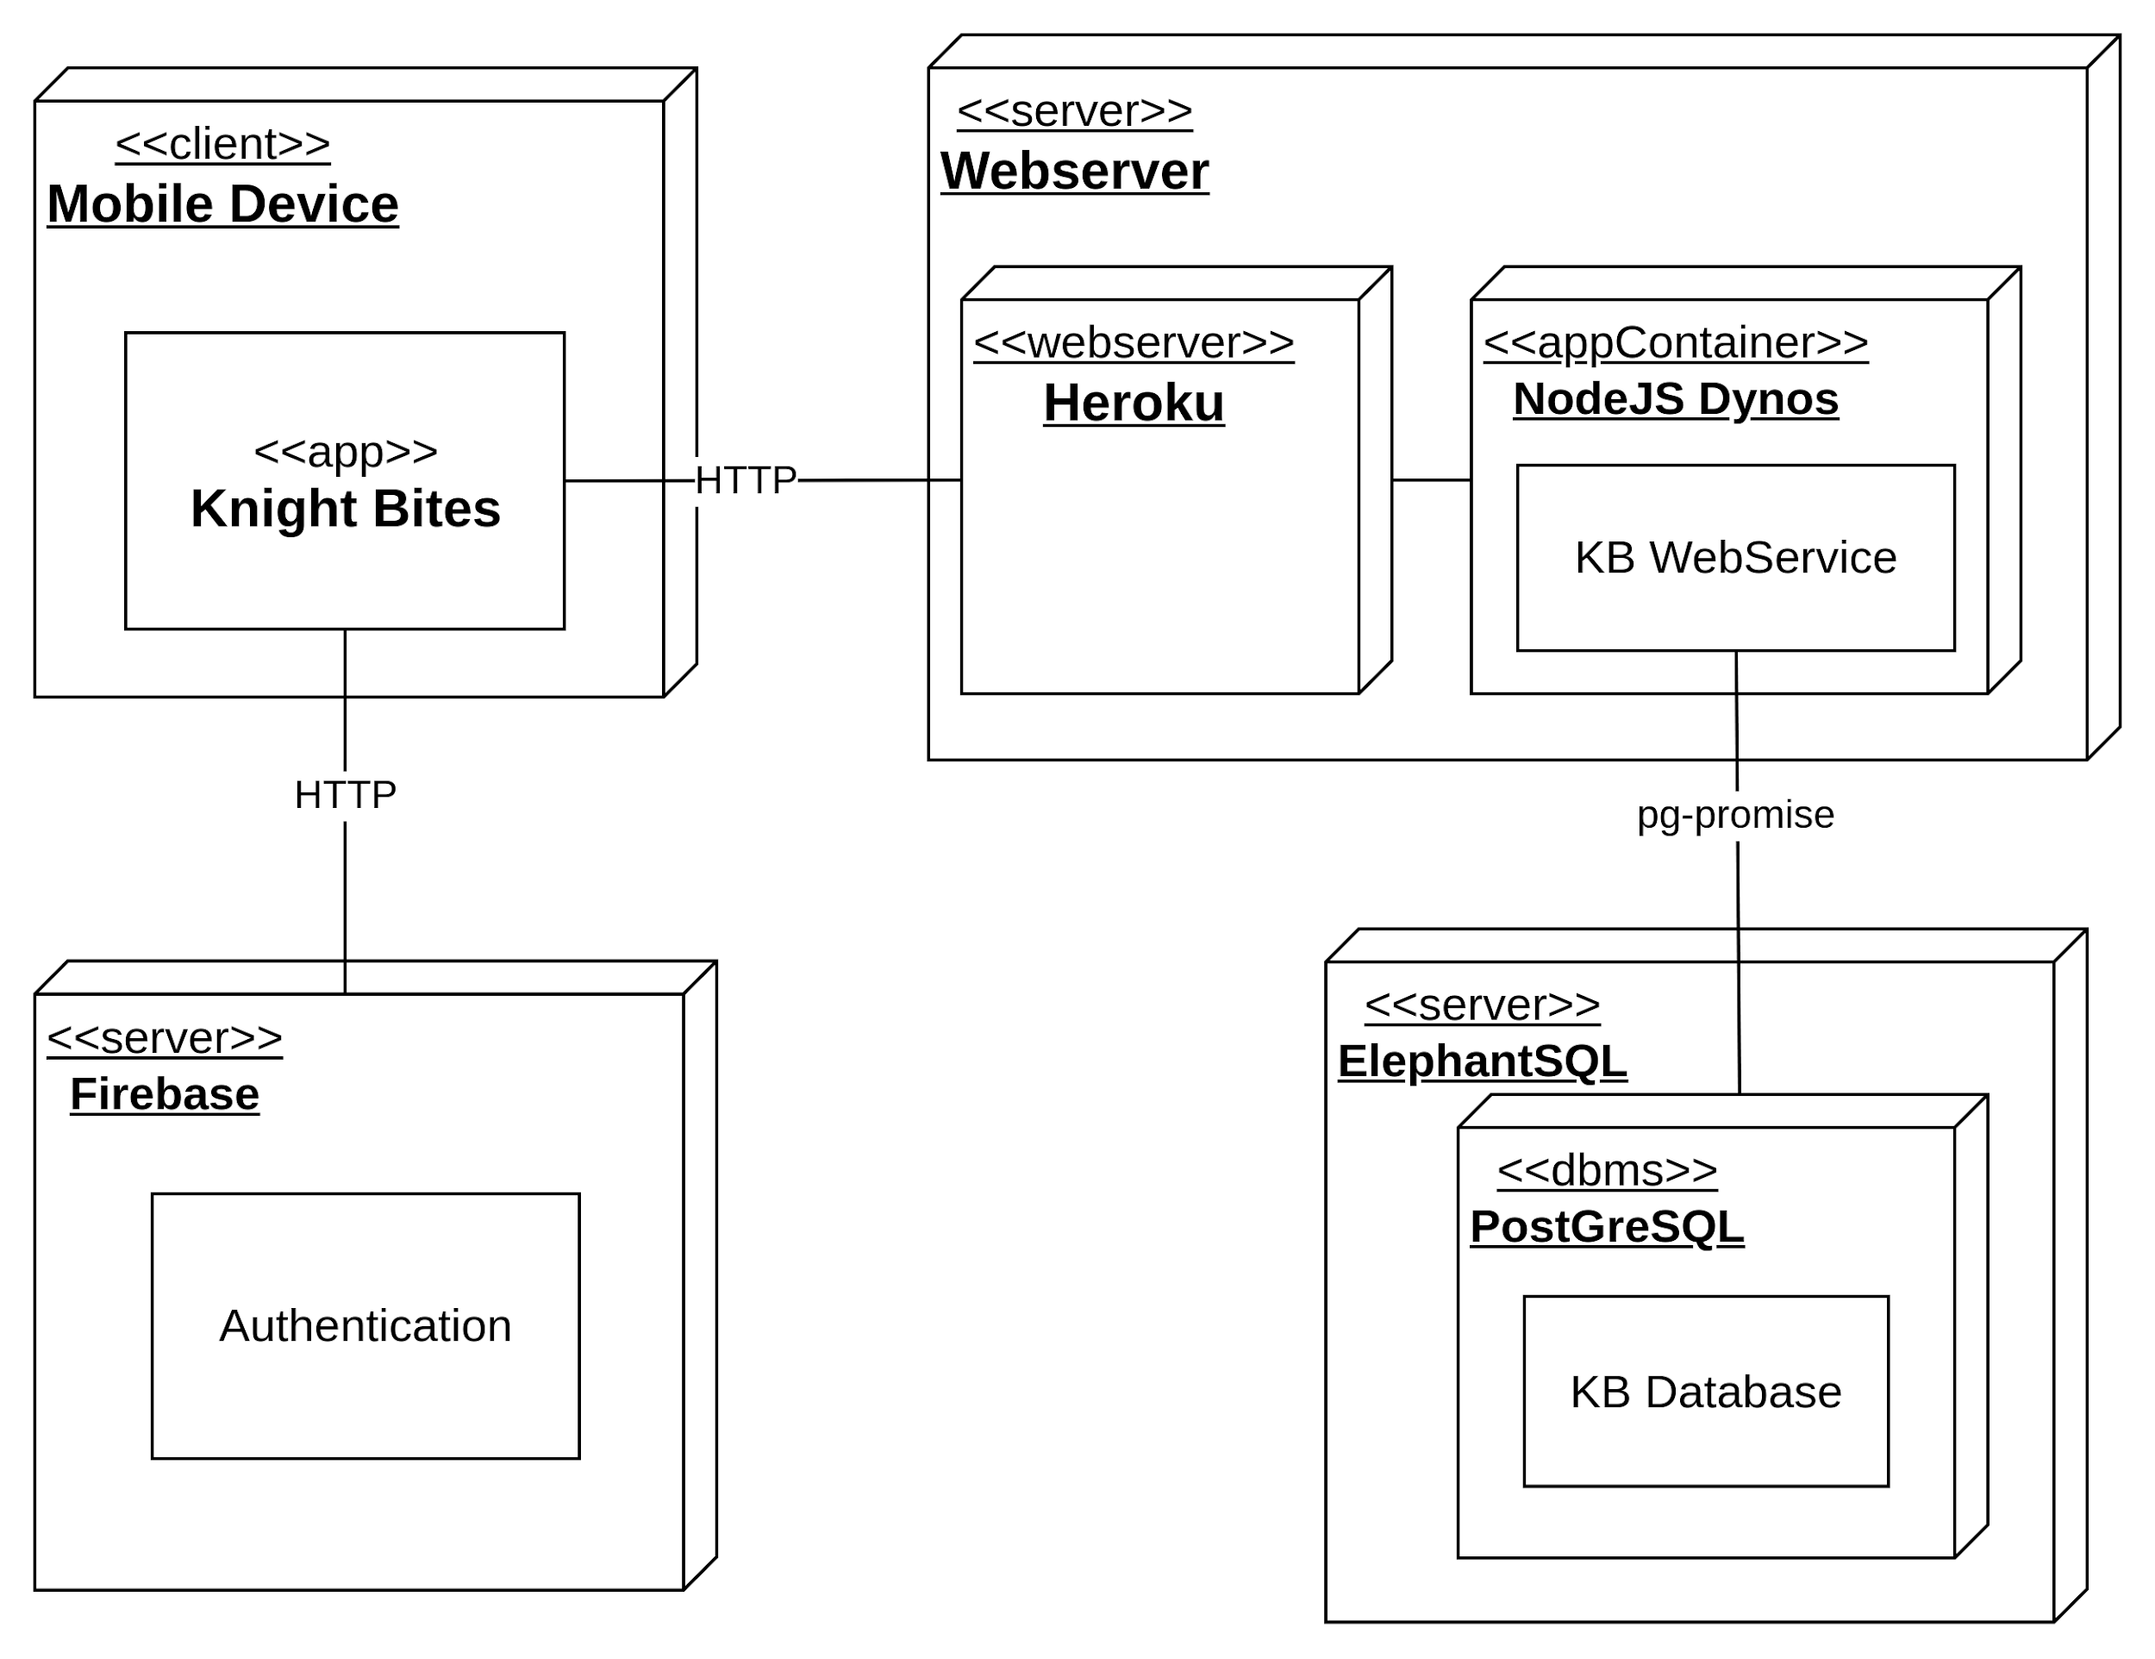
Deployment Diagram

Slide 6
Achievements
Authentication via Firebase.
All CRUD operations working.
Intuitive User interface.
Implementing the new user stories based on our user tests.

Slide 7
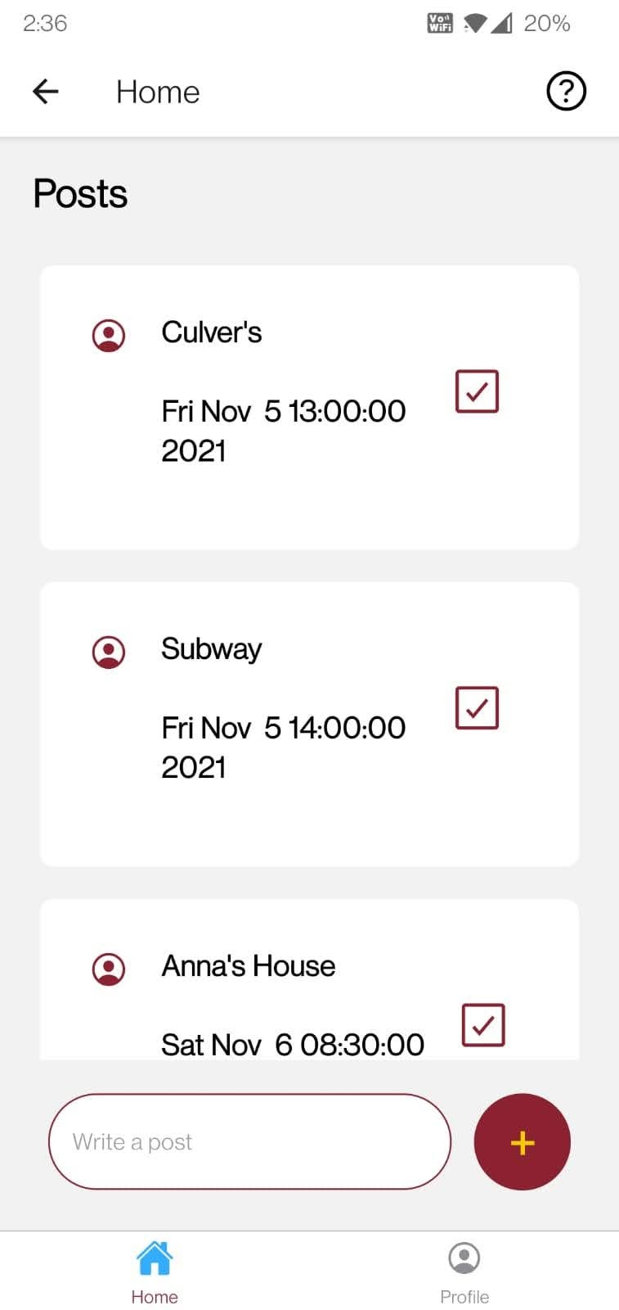
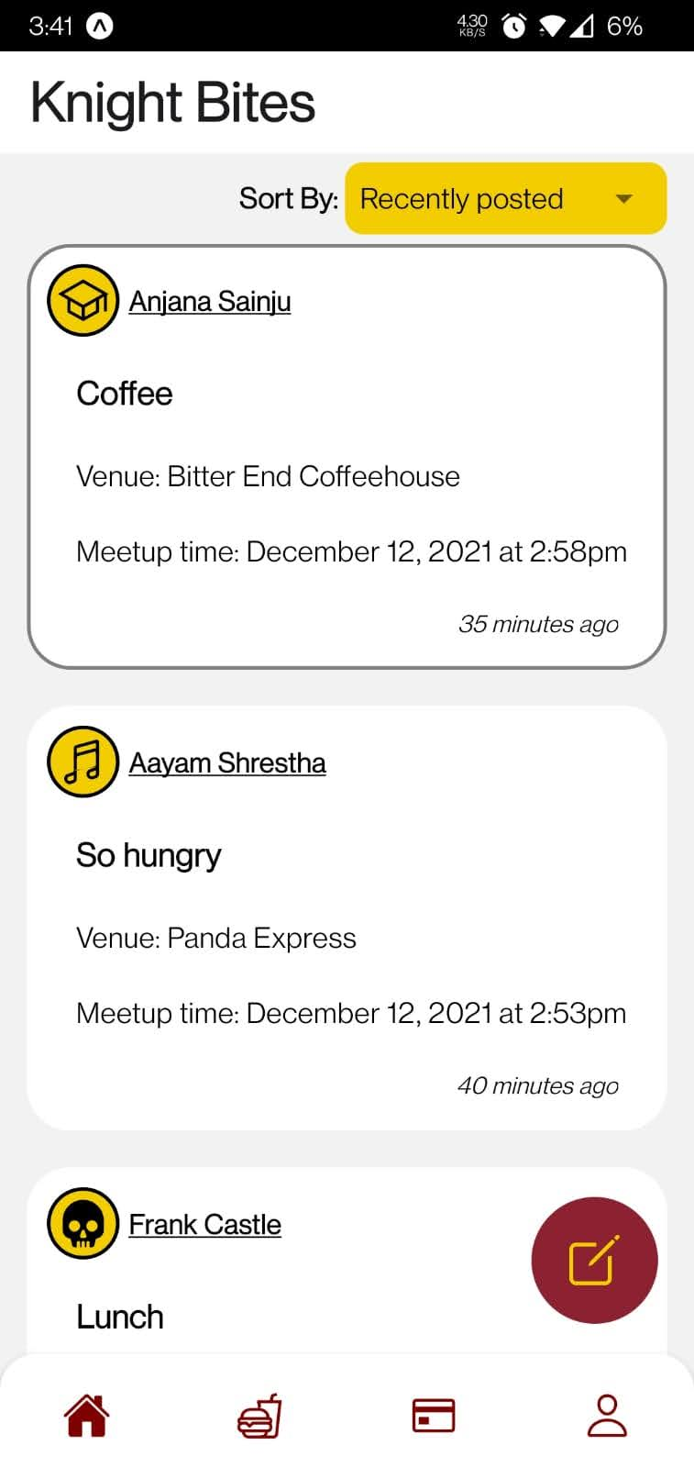
Previous Home Screen
Current Home Screen

Slide 8
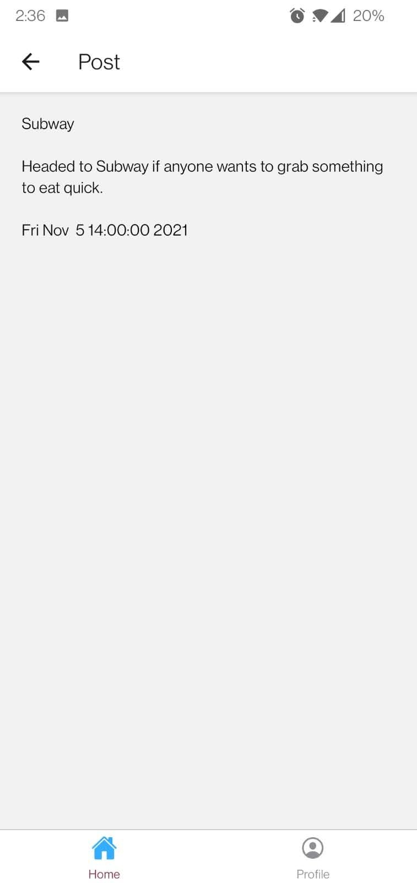
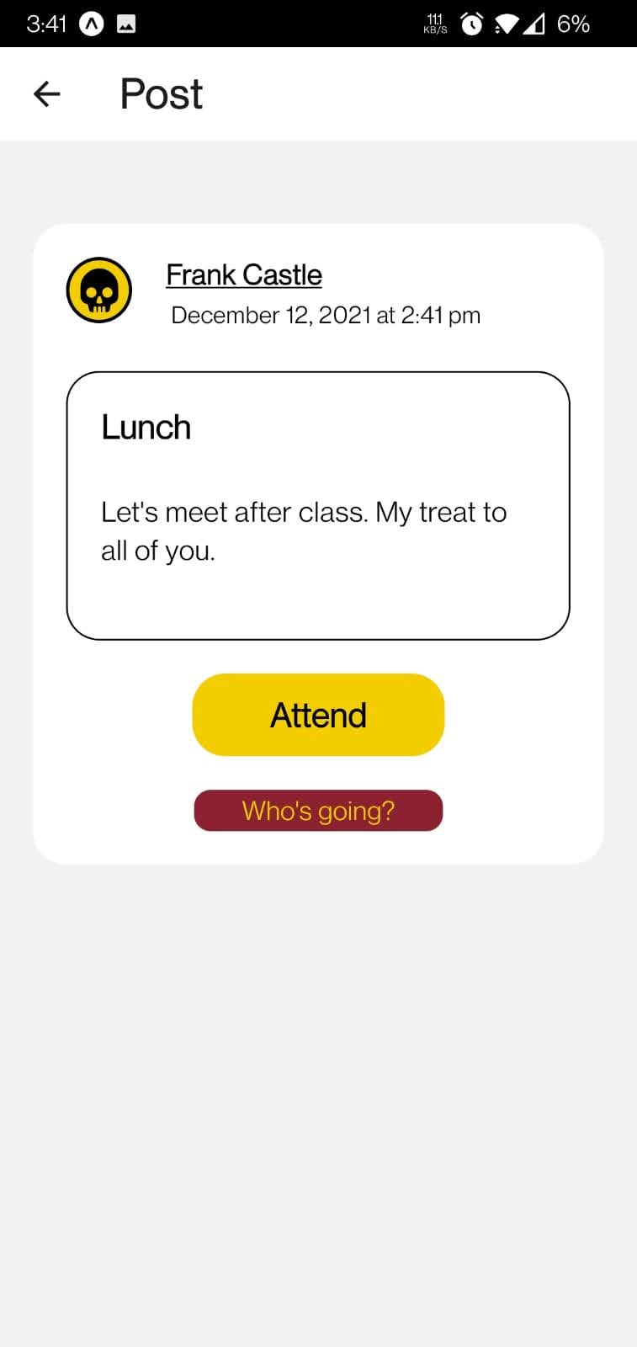
Previous Post Details Screen
Current Post Details Screen

Slide 9
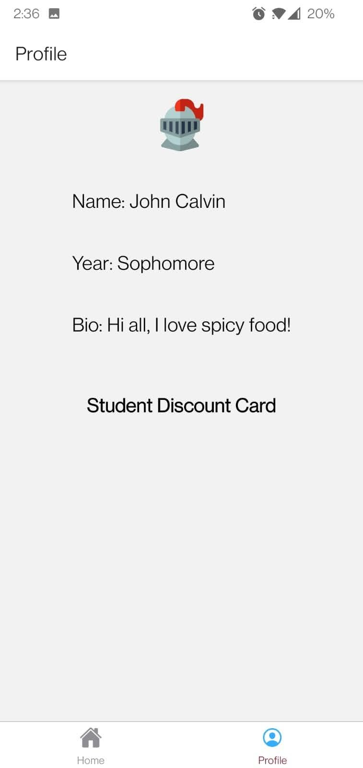
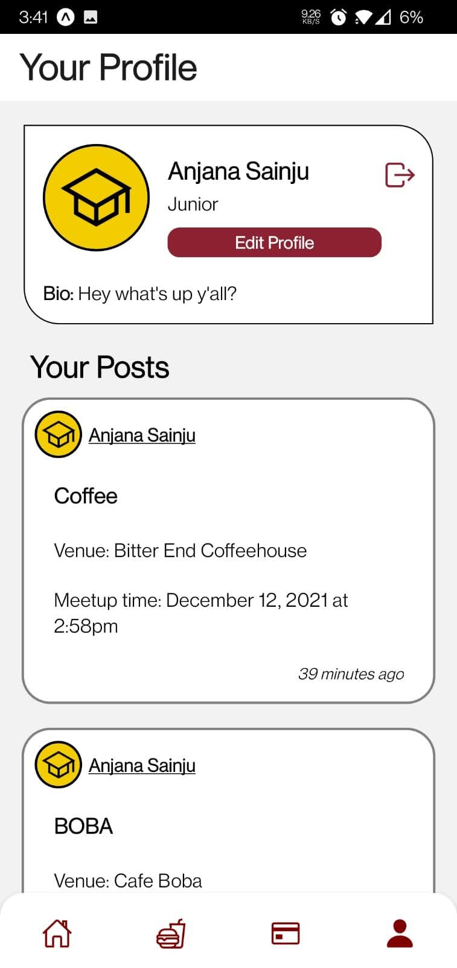
Current Profile Screen
Previous Profile Screen

Slide 10
Changes after usability tests
More colors added in the app
Sorting of posts by recent posts and meeting time
More details about the event in the home screen
Navigating through screens is easier
List of people going to a specific event
Confirmations for deleting, attending events

Slide 11
Potential Development and assessment
A notification system that interacts with your device’s calendar.
A chat feature that allows users to plan events more accurately.
A more customizable profile setup.

Slide 12
Questions?

